Slide 1
Platforms: Lecture 6: Memory

Slide 2
Datapath
ARM has a 3-stage fetch-decode-execute cycle
Fetch: fetch instruction code from memory into the instruction pipeline
Decode: instruction decoded to obtain control signals for the datapath ready for the next stage
Execute: instruction “owns” the datapath – register read; shifting; ALU results generated and write back

Slide 3
Datapath 2
In any processor, need multiple control signals in order to ensure that correct registers etc are active at the correct point in the cycle.
This could be implemented in a ROM or Programmable Logic Array
If done on a single clock cycle, then clock period cannot be shorter than the propagation delay through longest path in the processor. Obviously some instructions are simpler and could use shorter clock periods
Multiple-clock cycle datapath would be faster with different instructions taking different numbers of cycle (instruction is fissioned into steps. Allows faster clock cycles

Slide 4
Implementing Control
CISC (Complex Instruction Set Computers) such as x86 from Intel had multiple instructions of highly varied types, control of the system necessitated microprograms
RISC (Reduced Instruction Set Computers) were designed in a way that made such control simpler and more regular and hence facilitated hardwired control
Pipelining is the key to making RISC processors faster by design

Slide 5
Pipelining
Pipelining allows instructions to overlap in execution
The cycle is split into a number of stage (pipe stages). To complete execution, instruction uses all stages, but next instruction can start once the 1st instruction has completed first pipe stage
Pipelining improves instruction throughput rather than instruction execution time (latency)
Original pipelines had 5 stages:
IF (instruction fetch)
ID (instruction decode and register fetch)
EX (execution and effective address calculation)
MEM (memory access)
WB (write back data to registers)

Slide 6
Throughput
Assume operation times of functional units are:
Memory units (read/write) 10ns
ALU and adders 10ns
Register file (read/write) 5ns
Everything else is assumed to be negligible
A load instruction would be 10 (instruction fetch) + 5 (register reads) + 10 (ALU) + 10 (data access) + 5 (register write) = 40ns
Without pipelining, three load instructions take 120ns
With pipelining, each stage must take time of longest stage (e.g. 10ns), so total execution time can be reduced to 70ns
Speedup can approach 4:1, but requires balanced stages

Slide 7
Implementing Pipeline
Instruction flow is “left to right” but there are two exceptions:
Write back to register file
Selection of the next Program Counter value (on a branch instruction)
Add pipeline registers to store results from one pipe stage so that it can be used by next, so Instruction Fetch pipe stage reads instruction and writes the result into the Instruction Fetch / Instruction Decode register. On the next clock cycle, the Instruction Decode pipe stage reads instruction from IF/ID register while the IF stage retrieves the next instruction

Slide 8
Data and Branch Hazards
Pipelining is complicated by data and branch hazards
Data hazards occur when a value required in a register is not valid because a previous instruction has not yet updated:
SUB r1, r2, r3
AND r10, r2, r5
OR r11, r6, r2
ADD r12, r7, r2
STR r13, [r2]

Slide 9
Pipeline Stalling
One solution is pipeline stalling – ID stages of dependent executions not executed until data in r2 is available – introduces bubbles and reduces efficiency
Stalling can be implemented by adding a hazard detection unit into the pipeline
If a hazard is detected, it stops the Program Counter and IF/ID register from being written and selects zeros for the control values in the ID/EX register

Slide 10
Data Forwarding
Another solution is data forwarding
Instead of waiting on values being available in registers, pipeline registers are used instead
So results are fed back from EX/MEM backwards into the ALU input, for instance, or indeed forwarding values read and written during same cycle.
Forwarding can be implemented by adding multiplexors to inputs of the ALU and suitable control lines so that obsolete values can be ignored

Slide 11
Delayed Loads
Data forwarding fails when an instruction following a memory load requires the result of the load.
Two possible solutions:
Stall the pipeline with a hazard detection unit – hopefully only one stall cycle
Require (compiler) software to follow the load instruction with an instruction independent of the load – i.e. a delayed load. In extremis, the compiler would place a nop (NoOPeration) after the load.

Slide 12
Branch Hazards
Branches also cause hazards because address of the next instruction is not known until the branch instruction is executed.
In the meantime, if the pipeline is not corrected, the wrong instructions will execute and write their values to registers and memory
There are multiple solutions

Slide 13
Branch Hazards 2
Always stall on branches with several clock cycles penalty
Assume branch not taken and so instructions after branch start to execute. If branch is taken, the pipeline is flushed, the partial results discarded and execution resumes from branch target address
Use complex branch prediction heuristics (did it branch before?)
Use delayed branches by having the compiler reorder instructions so that useful work can be done without branch hazard risk

Slide 14
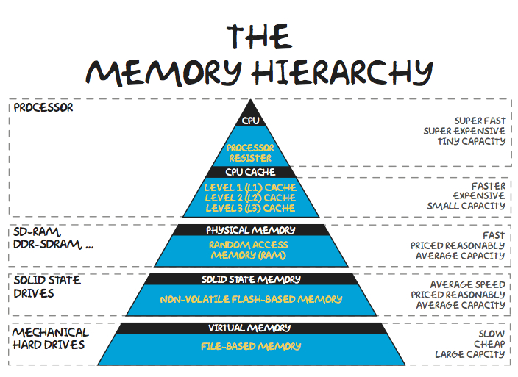
Memory Hierarchy
Temporal locality: if an item is referenced, it tends to be referenced again soon (loops, local variables)
Spatial locality: if an item is referenced, items with nearby addresses will tend to be referenced soon (instructions, data in arrays)

Slide 15
Registers 1
Single permanent storage locations within CPU, addressed directly by control unit
For particular defined purpose, wired for specific role
Used to hold binary values for storage, manipulation and/ or simple calculations
Can be small (single bit) or wide (word)
General-purpose registers (or accumulators) used for arithmetic operations (considered part of ALU)

Slide 16
Registers 2
Program counter register (PC)
Instruction register (IR) - hold actual instruction currently being executed
Memory address register (MAR) - holds address of a memory location
Memory data register (MDR) - holds data value being stored to or retrieved from location addressed by MAR
1-bit or flags - keeps track of special conditions: arithmetic carry and overflow, power failure, internal errors.
I/O interfacing can be carried out by two registers:
One to hold I/O address (for particular I/O device)
One to hold the I/O data.

Slide 17
Memory
Read Only Memory:
is relatively small,
essential as it contains the basic instruction set for operating the hardware in the system,
Non-volatile : the data remains intact when power is removed.
Random Access Memory,
volatile
provides the storage for all data required by the operating system and software
typically 4-8 Gb of system RAM installed,
graphics cards with their own additional memory (could be a Gb or more)

Slide 18
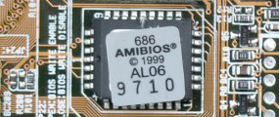
ROM
Contains the system BIOS
The role of the system BIOS is to
boot the system,
recognize the hardware devices,
locate and launch the operating system.
Once the operating system is loaded, the BIOS then works with it to enable access to the hardware devices
Can be updated by “flashing”

Slide 19
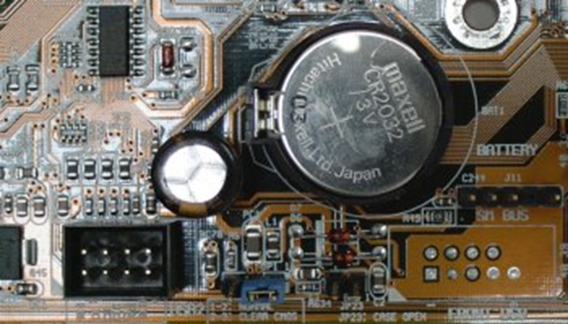
CMOS RAM
Was a memory chip with very low power requirements, retaining data when PC is shut off and relying on battery
Now a misnomer as typically an EEPROM
Capacity increased from 64 bytes to 512 bytes
Its function is to store information your computer needs when it boots up, such as hard disk types, keyboard and display type, chip set, the time and date.
Battery still needed for real-time system clock

Slide 20
RAM (Random Access Memory)
Uses a memory cell array for storing bits of data, which is a matrix of columns and rows (much like a spreadsheet).
Any individual memory cell can be accessed as easily/fast as any other
Each cell stores a single bit
Each individual cell can be written to and read from and is uniquely addressable
e.g. 4 MB chip,
4,194,304 memory cells
in a matrix of 2048 rows and 2048 columns

Slide 21
RAM 3
L1 cache
Internal to CPU
Uses SRAM
L2 cache
Now internal to CPU
Uses SRAM
L3 and L4 caches in some systems
Main Memory
In modules pluggable into motherboard sockets
Uses DRAM

Slide 22
RAM 2
There are only two types of RAM:
Dynamic Random Access Memory (DRAM)
Must have electrical current supplied to maintain their electrical state (refresh)
Slower and less expensive
Static Random Access Memory (SRAM)
Do not need electrical current or circuitry for refresh purposes
Faster and more expensive

Slide 23
L1 Cache
Internal to CPU
Fast, small
used for temporary storage of instructions and data organised in blocks of 32 bytes
Improves data access times in cases when the CPU accesses the same data multiple times
Split into two:
one to store program data, other to store microprocessor instructions.
was traditionally 16kB in size, now 64kB+

Slide 24
L2 Cache
Can be
on the processor core - integrated or on-die cache.
in the same package/cartridge as the processor, but separate from the processor core - backside cache. This type of L2 cache was used in Pentium Pro, Pentium II, early Pentium III and slot A Athlon processors.
separate from the core and processor package. In this case L2 cache memory is usually located on the motherboard.
typically in sizes such as 256KB, 512KB or 1 MB
access time in the range 4.5 to 8 nanoseconds - faster than main memory, slower than L1 cache

Slide 25
L2 Cache
Its purpose is to supply stored information to the L1 cache on the processor. By data prefetching the level 2 cache may also be used to buffer program instructions and data that the processor is about to request from memory.
special transfer protocol called burst mode
A burst cycle consists of four data transfers where only the address of the first 64 bits are output on the address bus

Slide 26
Caches
Efficient operation depends upon principle of locality
Temporal locality: if an item is referenced, it tends to be referenced again soon (loops, local variables)
Spatial locality: if an item is referenced, items with nearby addresses will tend to be referenced soon (instructions, data in arrays)
If requested data is present in an upper level (e.g. cache), this is a hit, otherwise a miss.
Aim for a high hit rate, especially for levels where there is a large miss penalty (e.g. disk fetches which are milliseconds)

Slide 27
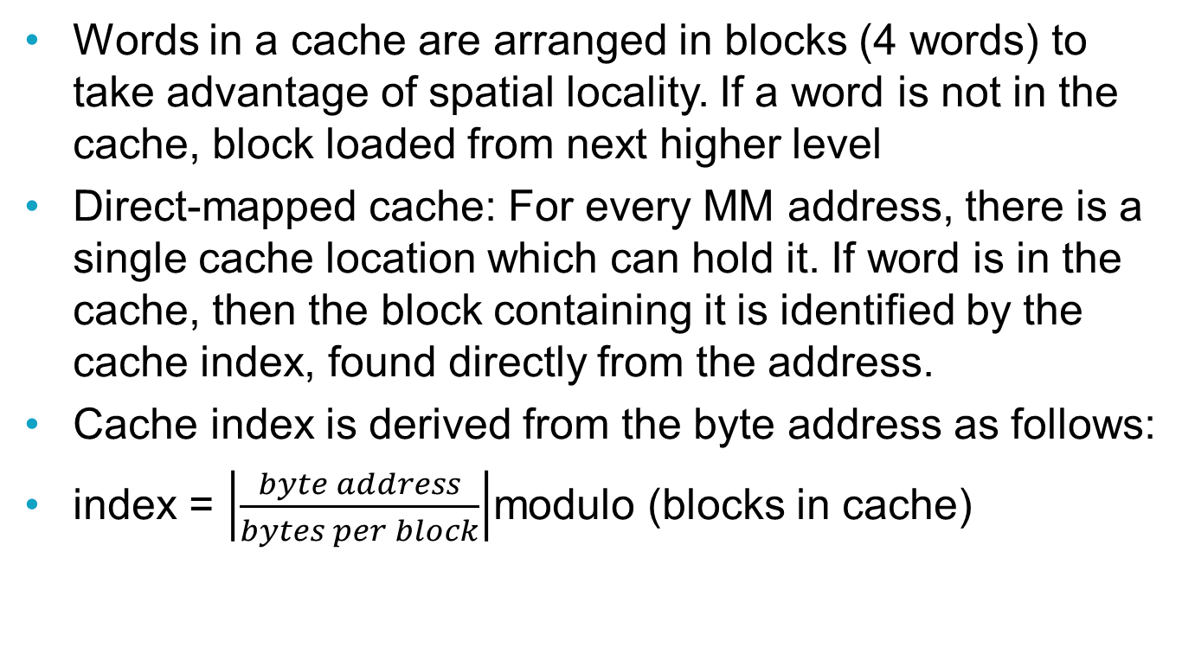
Direct-mapped Caches 1
Words in a cache are arranged in blocks (4 words) to take advantage of spatial locality. If a word is not in the cache, block loaded from next higher level
Direct-mapped cache: For every MM address, there is a single cache location which can hold it. If word is in the cache, then the block containing it is identified by the cache index, found directly from the address.
Cache index is derived from the byte address as follows:
index = $\left|\frac{byte address}{bytes per block}\right|$modulo (blocks in cache)
Notes:
Example: 4-block cache, 1-word blocks

Slide 28
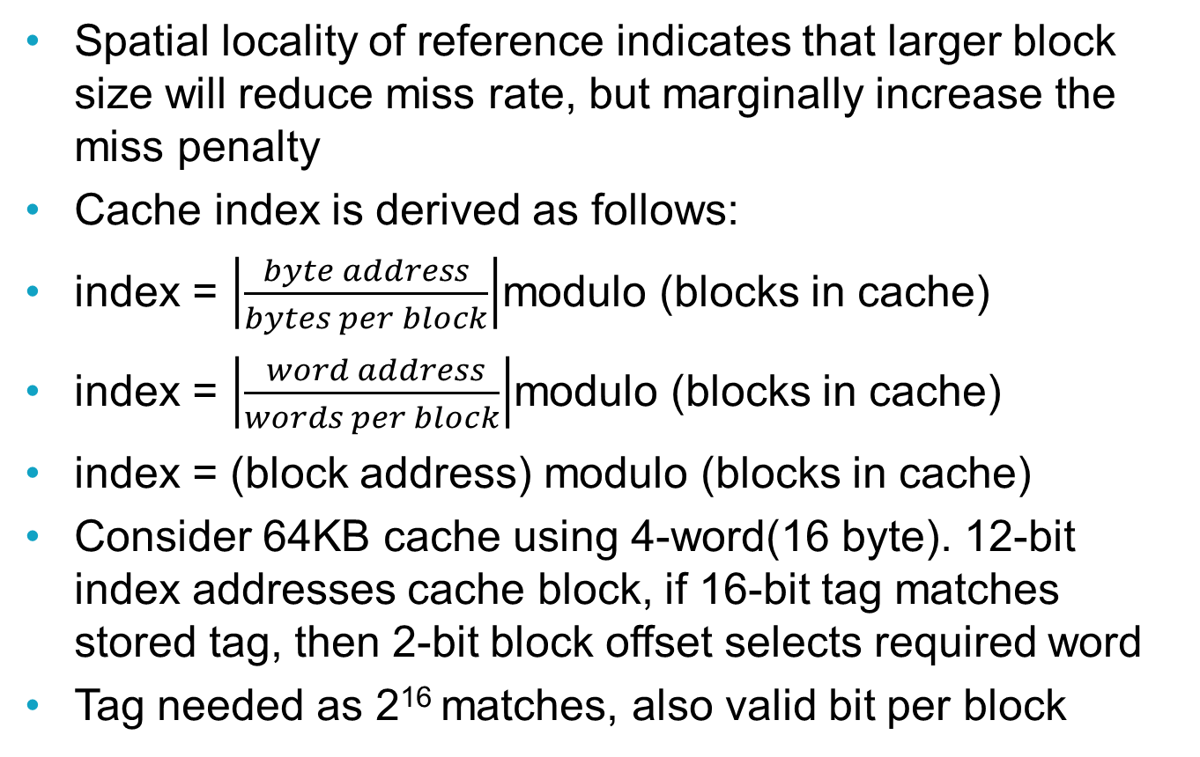
Direct-mapped Caches 2
Spatial locality of reference indicates that larger block size will reduce miss rate, but marginally increase the miss penalty
Cache index is derived as follows:
index = $\left|\frac{byte address}{bytes per block}\right|$modulo (blocks in cache)
index = $\left|\frac{ word address}{words per block}\right|$modulo (blocks in cache)
index = (block address) modulo (blocks in cache)
Consider 64KB cache using 4-word(16 byte). 12-bit index addresses cache block, if 16-bit tag matches stored tag, then 2-bit block offset selects required word
Tag needed as 2¹⁶ matches, also valid bit per block
Notes:
Example: 4-block cache, 4-word blocks
Byte address is 31 to 16 as tag, 15 to 4 as 12-bit index, 3 & 2 as block offset, 1 and 0 as byte offset

Slide 29
Handling Cache Misses
On a cache miss, required block needs to be copied from memory management into cache and current cache block replaced
On a miss for the instruction cache:
Compute PC-4 and store in PC. Resets the PC which would already have been incremented so that it points again at missed instruction
Instruct MM to read requested block and wait to complete (several clock cycles)
Write data and tag into cache and set valid bit to 1
Restart the pipeline, which will fetch the instruction again, this time finding it in the cache
A cache miss is similar to a pipeline stall but stalls entire machine

Slide 30
Cache Writes
On writing, if block is not already in cache, the block must be read from MM and relevant word updated in cache
MM must be updated on a write:
Write through: data written to cache and also to MM. To avoid stalling the processor, while MM is updated, use write buffers. Advantage: read misses are cheaper as they never require a write to MM and easier to implement
Write back/copy back: data is written only to the cache and modified block is written to MM only when it is replaced in the cache. Advantage: words written at cache rather than MM speed; multiple writes to a block only require one write to MM

Slide 31
Associative Caches
Direct-mapped caches have disadvantage that there is no choice on which block to replace when get a cache miss. Could potentially replace same block repeatedly
More flexible approach is fully associative cache which allows a memory block to reside anywhere in cache. Accessing a word entails a full search of cache to see if requested block is present.
A set associative cache is a compromise. It has a number of locations (≥ 2) where block can reside. Each MM block maps to a unique set and all blocks in the set must be searched for requested block and tag field extended to identify each set member
(block address) modulo (sets in cache)

Slide 32
Block Replacement Strategies
Two main strategies for associative caches:
Random: candidate blocks are randomly selected
Least recently used: block replaced is the one that has been unused for longest time
Random selection is easy to build and for 2-way set associative random replacement miss rate is only 1.1 higher than LRU
LRU more attractive with higher set associativity and when miss penalty is high, though slower, harder to implement (usually approximated)

Slide 33
Cache Performance
Execution time = (CPU execution cycles + memory stall cycles) x clock cycle time
Memory stall cycles = instructions in program x misses per instruction x miss penalty
As CPUs improve, memory stall cycles degrade performance, so:
Reduce miss rate (better cache strategies). Multilevel cache with onchip small cache (very fast), possibly set associative and large (1MB+) off-chip cache, probably direct-mapped
Reduce miss penalty (faster memory). Increase bandwidth to MM by wider memory bus (eg 128 bits) or interleaved memory banks

Slide 34
Main Memory
RAM
Volatile:
memory contents are lost without power
built up using DRAM (Dynamic RAM) chips
Memory cells that need continual refreshing of their data; achieved by circuitry on the memory module

Slide 35
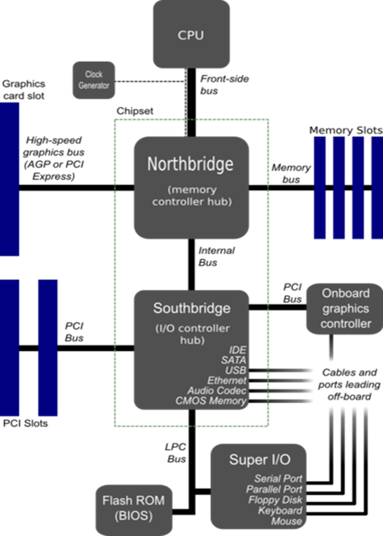
Main Memory 2
Attached to CPU via Northbridge controller
Memory bus and Front Side Bus run at same speed
typically 32 (SIMM) or 64-bit (DIMM) wide address and data busses
Northbridge / FSB system may be replaced as a slow FSB can become a bottleneck that slows down a fast CPU

Slide 36
SDRAM 1
Synchronous Dynamic RAM
first type of main PC memory
‘synchronous’ = access is controlled by a clock
Designed to fetch all the bits in a burst as fast as possible (as most PC memory accesses are sequential)
on-chip burst counter allows the column part of the address to be incremented very rapidly
The memory controller provides the location and size of the block of memory required and the SDRAM chip supplies the bits as fast as the CPU can take them, using a clock to synchronise the timing of the memory chip to the CPU's system clock
Notes:
Synchronous
In most systems, the memory bus (and FSB) operate at the same sub-multiple of the system clock. e.g System clock 1.4GHz, but FSB and memory bus clock speed could be (1/7) =200 MHz, 400 MHz or 800 MHz
In some BIOS the ratio between FSB clock speed and system clock speed can be altered (cf. overclocking)
{Some chipsets (nVidia 680i ) have different memory bus and FSB clock speeds}
For SDRAM , memory access occurs on the leading edge of the memory bus clock
_____ _____ _____ _____ __
Clock _| |_____| |_____| |_____| |_____|
Access | | | | |

Slide 37
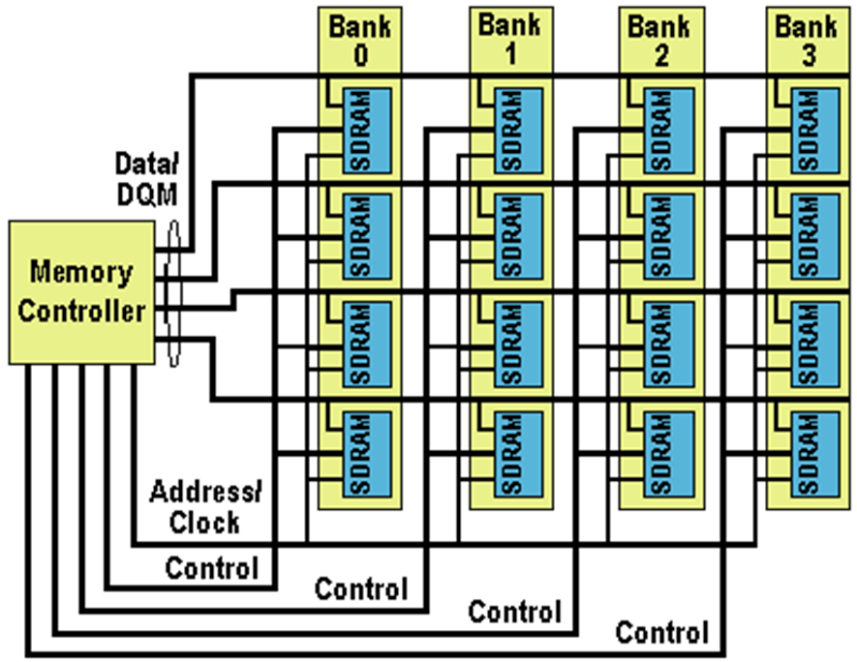
SDRAM 2
Data can be delivered off-chip at burst rates of up to 100MHz
Once the burst has started all remaining bits of the burst length are delivered at a 10ns rate.

Slide 38
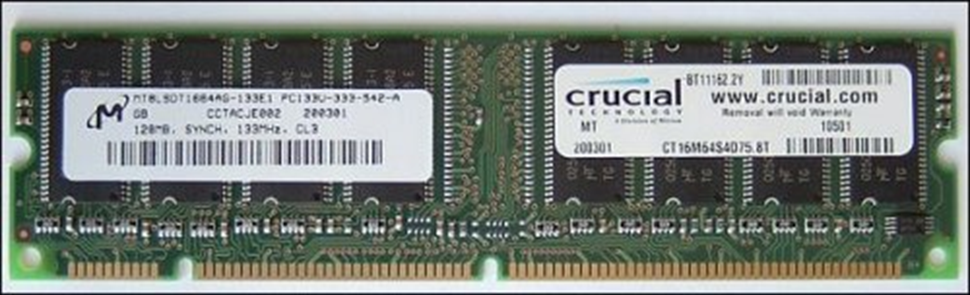
SDRAM 3
Earlier 74-pin SIMM modules had the same SDRAM memory chips. OK for 32 bit wide memory bus, but modules had to be in pairs to be used with the later 64-bit wide data bus
Then in a 168 pin DIMM (Dual Inline Memory Module)
Electrical contacts both sides of the module
64-bit wide data bus
SDRAM replaced by DDR SDRAM from 1999

Slide 39
DDR SDRAM
Double Data Rate
Operates on both leading and trailing edge of clock to double SDRAM data transfer speed
initially DDR
Chip speeds up to DDR 400 meaning on a 200MHz bus, 400MTransfers/s
Module numbered by bandwidth (maximum amount of data they can deliver per second), i.e. PC3200 uses DDR400 chips → 3.2GBps.
then DDR2
External data bus is operated at twice clock rate
e.g. DDR2-1066 (package PC2-8500) @memory clock 266MHz (I/O bus 533MHz), data transfers: 1066MTransfer/s transferring 64 bits at once →8.53GB/s
Notes:
DDR: Access on both Leading & trailing edges of memory clock
_____ _____ _____ _____ __
Clock _| |_____| |_____| |_____| |_____|
Access | | | | | | | | |

Slide 40
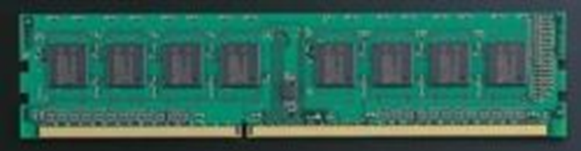
DDR3 SDRAM
DDR3 modules can transfer data up to 1600 MHz using both rising and falling edges of a 800 MHz I/O bus speed
PC3-12800 band width of 12.8 GB/s
DDR3 memory chips in a 240-pin DIMM package
different notches to DDR2 DIMM modules

Slide 41
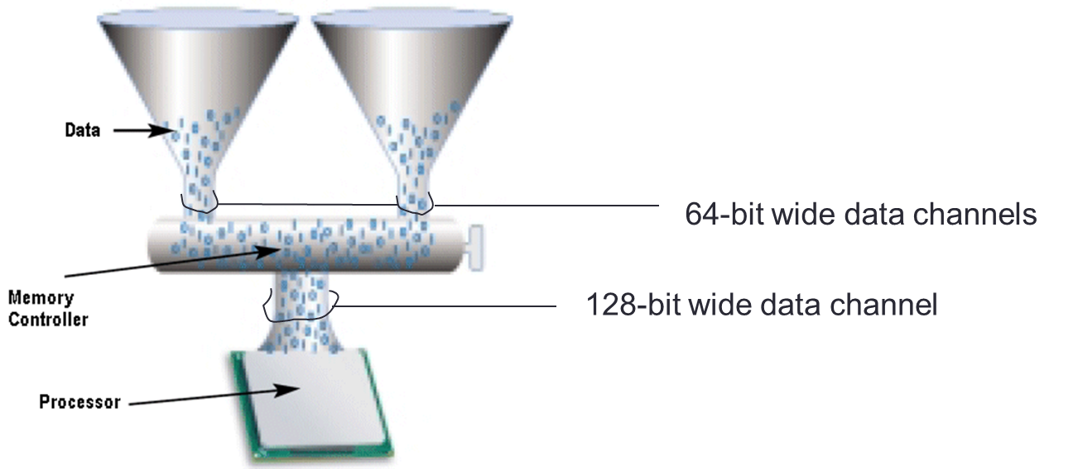
Dual Channel
To increase data throughput by using two memory channels instead of one
Dual channel architecture can increase data throughput by 10%
DIMMs must be installed in pairs. Both DIMMs must use the same density memory chips, the same DRAM bus width, and must both be either single-sided or dual-sided

Slide 42
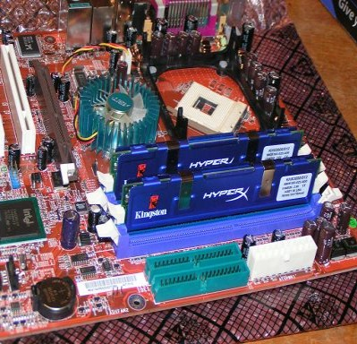
Dual Channel 2
Here a matched pair of DDR2 memory modules, on a board which supports dual-channel memory access

Slide 43
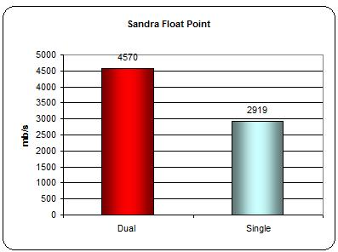
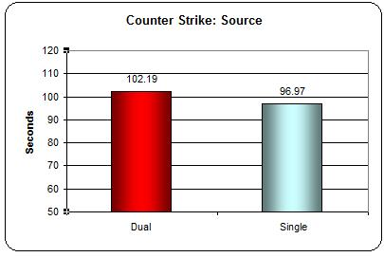
Dual Channel 3
The effect of using dual channel architecture to improve memory bandwidth
Floating point arithmetic benchmark 57% improvement
Frames /sec in a game benchmark, 6% improvement, Video card could be a bottleneck here

Slide 44
Graphics memory
RAM, usually on a graphics card
holds the information necessary to drive a VDU.
used to be typically 64MB or 128MB of DDR2 or DDR3, but now can be up to 1GB
For 2D graphics:
for 1600 by 1200 resolution, with 32 bit colour, → 61,440,000 bits → 7,680,000 bytes → 7.68MB
Amount of video memory 2x more than expected as:
Double buffering /page flipping renders the upcoming frame into another area of memory from the frame buffer, so the incoming data doesn't affect the currently-displayed frame.
So 16MB sufficient for basic 2D graphics

Slide 45
3-D Graphics Memory
Memory needed for
Z-buffer
Depth: what's in front of what in the rendered scene
Simple vertex data
low-level rendering information, often as a block of pre-calculated objected vertex information for each frame
programs done by the Graphics Processing Unit (GPU) rather than the CPU
Surface rendering/textures: requiring light maps, bump maps, overlays
Game playing has pushed what is required, leading to graphics cards with 256, 512 and even 1 GB or more of memory – see NVIDIA graphics cards for a modern specification and graphics processors

Slide 46
Virtual Memory
In modern operating systems, including Windows, application programs and many system processes always reference memory using virtual memory addresses which are automatically translated to real (RAM) addresses (and sometimes hard disk addresses) by the hardware.
Virtual Memory is always in use, even when the memory required by all running processes does not exceed the amount of RAM installed on the system.
RAM is a limited resource, whereas virtual memory is, for most practical purposes, unlimited. There can be a large number of processes/programs each with its own chunk (e.g. 2 GB) of private virtual address space.

Slide 47
Virtual Memory 2
Programs use virtual addresses translated by hardware and OS into physical addresses used to access main memory
VM and MM divided into chunks called pages, typically 4-16Kb in size
Translate virtual page number to physical page. If requested page not in memory, have page fault and have to fetch page
In Windows systems, these “paged out” pages are stored in one or more files called pagefile.sys in the root of a partition. This can become a very large file
Virtual memory is cache for main memory
Notes:
Virtual address 32-bit value – 20 bits for virtual page number, bottom 12 bits for page offset

Slide 48
Virtual Memory Design
VM design choices are motivated by high cost of a miss (disk access takes 100s of 1000s of cycles). So:
Pages tend to be large
Flexible replacement of pages is essential
Misses are handled by operating system software so very sophisticated page replacement strategies can and are used
Write-through isn’t sensible as need to minimise number of disk writes

Slide 49
Page Tables 1
VM systems use fully associative page placement
Location of pages stored in structure called page table, indexed by virtual page number and contains physical page number
Page table is large with 1 entry per virtual page number
Each running program (process) has own page table in MM and MM hardware contains a register (page table register) which points to start of the page table
For each page table entry, there is a valid bit to determine whether the page is in memory. If data is required and valid bit is zero, page fault occurs

Slide 50
Page Tables 2
On page fault, control is transferred to operating system which fetches the required page from disk.
Operating system will implement a Least Recently Used strategy to exploit temporal locality
Writes use write-back. To save writes when a page hasn’t changed, page table includes a dirty bit to show that the page’s contents differ from disk data. Dirty bit set first time page is modified in MM

Slide 51
Translation Lookaside Buffers
Page tables are large and need to be stored in main memory, which slows down memory access, as even if referenced word is in cache, still have to access page table in MM to get physical address
Solution is to exploit locality of reference to the page table and have a special, fast cache to store recently used translations – the translation lookaside buffer (TLB)
TLB caches only those portions of the page table pointing to MM addresses. Each tag entry holds a portion of the virtual page number and each data entry contains a physical page number and a dirty bit

Slide 52
Translation Lookaside Buffers
On every memory reference, look up in the virtual page number in TLB. If get a hit, then generate the physical address from TLB and access the cache
On a TLB miss, if page exists in MM, then TLB entry can be updated from the page table and the translation retried. Otherwise a page fault is generated.
TLB is often fully associative with LRU replacement
Write-back used to ensure that dirty bits in page table stay current
As thousands of consecutive memory references could be to same page, TLBs work

Slide 53
Translation Lookaside Buffers
TLB values:
Block size 1-2 page table entries (4-8 bytes each)
Hit time ½ to 1 clock cycle
Miss penalty 10-30 clock cycles
Miss rate: 0.01% to 1%
TLB size: 32-1024 entries

Slide 54
Hard Disk Cache
All modern hard disks contain an integrated cache, also often called a buffer.
Not normally thought of as part of the regular PC cache hierarchy, the function of cache is to act as a buffer between a relatively fast device (interface/bus) and a relatively slow one (the disk).
Most modern hard disks have between 512 kB and 2 MB of internal cache memory, although some high-performance SCSI drives have as much as 16 MB (or more)

Slide 55
Hard Disk Cache 2
The use of a cache improves performance of any hard disk, by reducing the number of physical accesses to the disk on repeated reads and allowing data to stream from the disk uninterrupted when the bus is busy
A hard disk's cache is important is due to the sheer difference in the speeds of the hard disk and the hard disk interface.
Finding a piece of data on the hard disk involves random positioning, and incurs a penalty of milliseconds

Slide 56
Hard Disk Cache 3
On a typical IDE/ATA hard disk, transferring a 4,096-byte block of data from the disk's internal cache is over 100 times faster than actually finding it and reading it from the platters.
If a seek isn't required (say, for reading a long string of consecutive sectors from the disk) the difference in speed isn't nearly as great, but the buffer is still much faster
For hard disks, the cache is used to hold the results of recent reads from the disk, and also to "pre-fetch" information that is likely to be requested in the near future, for example, the sector or sectors immediately after the one just requested.

